Slide 1
An Introduction to the ACGME
Dean Seehusen, MD, MPH
Associate Dean for Graduate Medical Education
Professor of Family Medicine

Slide 2

Daily Influence

Slide 3
ACGME Competencies
Patient Care
Medical Knowledge
Practice Based Learning and Improvement
Systems Based Practice
Professionalism
Interpersonal Skills and Communication
WWW.ACGME.ORG.

Slide 4
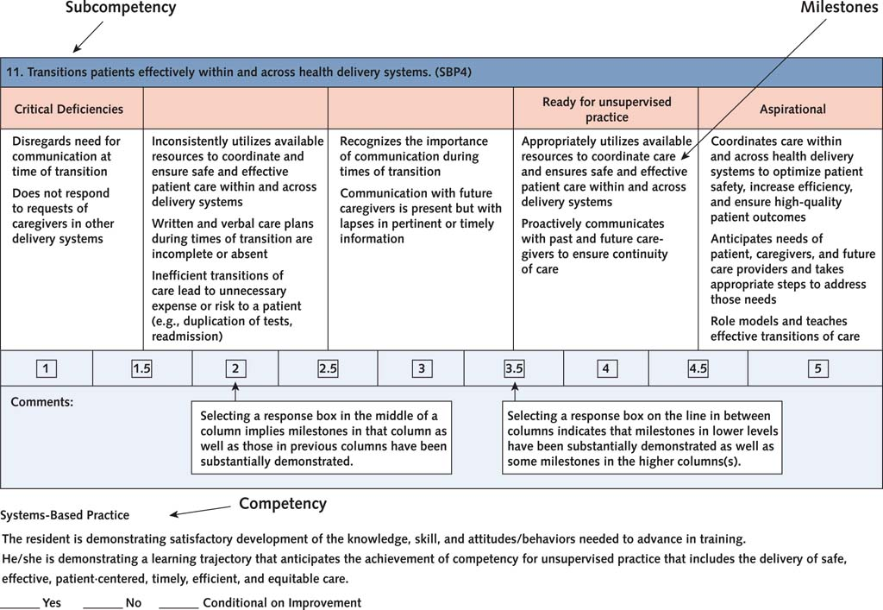

Slide 5
CCC
Clinical Competence Committee (CCC)
Minimum of three faculty members
Duties
  Review all resident evaluations semi-annually
  Prepare Milestone evaluations semi-annually
  Advise the PD regarding resident progress, including promotion (graduation), remediation, dismissal
ACGME. Common Program Requirements.

Slide 6
PEC
Program Evaluation Committee (PEC)
At least 2 faculty and 1 resident/fellow
Duties
  Actively participate in planning, developing, implementing, and evaluating educational activities
  Review and revise curriculum goals and objectives
  Address areas of non-compliance with ACGME standards
  Review the annual program evaluation (APE) in a formal, systematic manner
ACGME. Common Program Requirements.

Slide 7
Online Data Entry
Accreditation Data System (ADS)
  Yearly entry/validation of data to demonstrate a program is meeting requirements
  Similar across all specialties
  Useful for generating reports
Resident Case Log System
  Recording and tracking mechanism for procedures
  More heavily used in surgical subspecialties
WWW.ACGME.ORG.

Slide 8
ACGME Surveys
Resident Surveys
Faculty Surveys
Related to outcomes
  There is a positive correlation between noncompliance reported on resident and faculty surveys and programs with less than 80% ABIM pass rate
Holt KD, Miller RS, Vasilias J, Byrne LM, Cable C, Grosso L, Bellini LM, McDonald FS. Relationships Between the ACGME Resident and Faculty Surveys and Program Pass Rates on the ABIM Internal Medicine Certification Examination. Acad Med. 2018 Aug;93(8):1205-1211.

Slide 9
ACGME Hot Topics
CLER Visits
QIPS
Well-Being
Duty Hours
Supervision
Transitions of Care
Professionalism
Scholarship

Slide 10
Clinical Learning Environment Review (CLER) Visits
Every 24 +/- 6 months
Focused on institutional leadership
Designed to provide periodic feedback that addresses focus areas:
  patient safety
  health care quality
  care transitions
  supervision
  well-being
  professionalism
Results are “fire-walled” off from the ACGME
WWW.ACGME.ORG.

Slide 11

PDSA Cycle
Philibert I, Lieh-Lai M. The Program Self-Study in the Next Accreditation System. ACGME Webinar. May 9, 2014.

